Slide 1
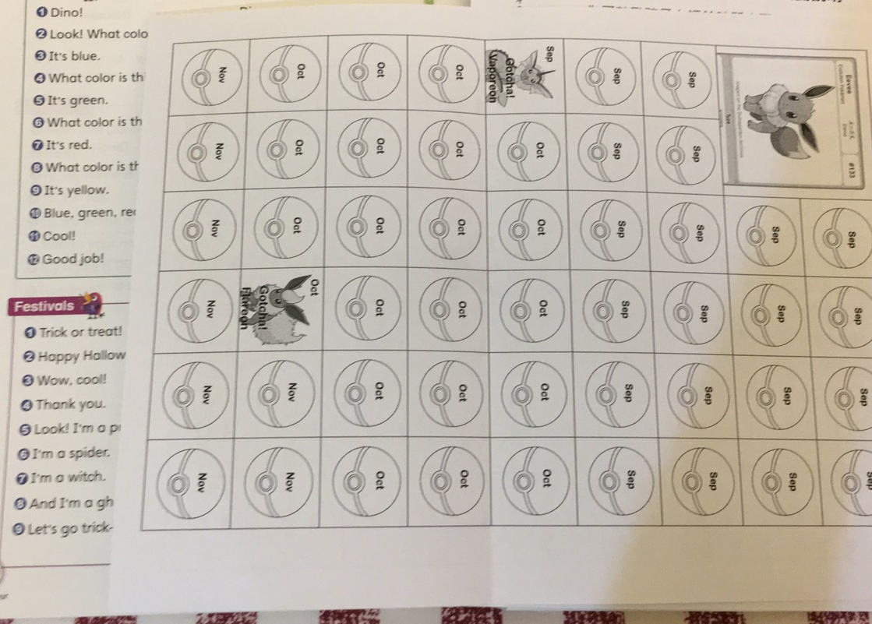

Slide 2
一次獲得10個印章
進化區點心任選1
進化區用品(文具or玩具)任選1
招式區任選3種小點心

Slide 3
Where are they from?
Liam
Zayn
Harry
Niall
Louis

Slide 4
Let’s read aloud!

Slide 5
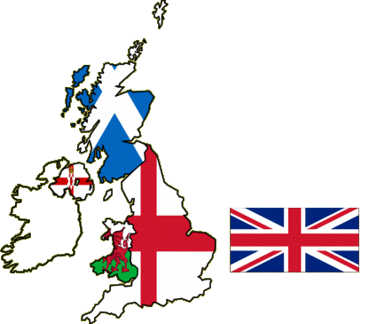
United Kingdom of Great Britain
and Northern Ireland
大不列顛及北愛爾蘭聯合王國
the United Kingdom
the UK
Britain

Slide 6
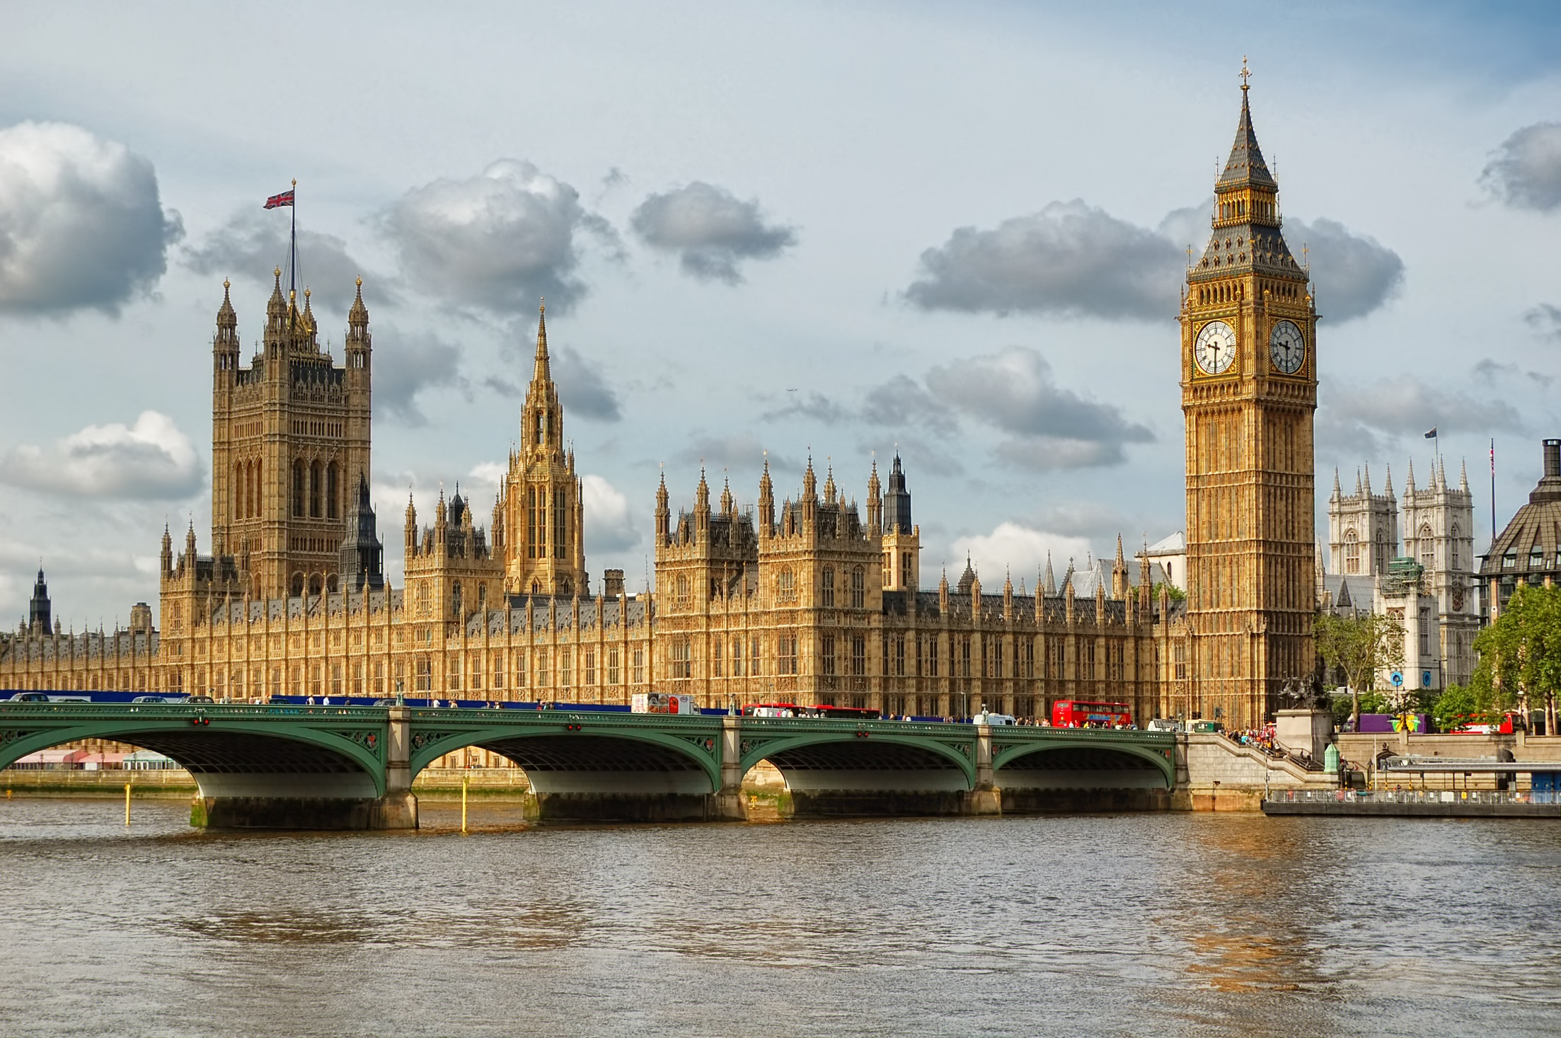
The UK is famous for…
Big Ben
Houses Of Parliament
River Thames

Slide 7
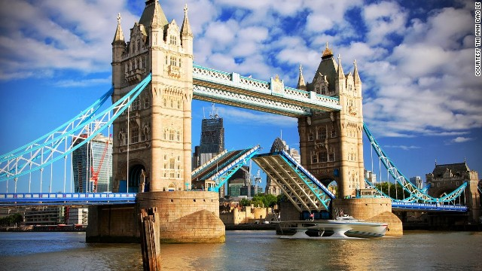
London Bridge’s falling down, falling down, falling down….
Tower Bridge

Slide 8
London Eye

Slide 9
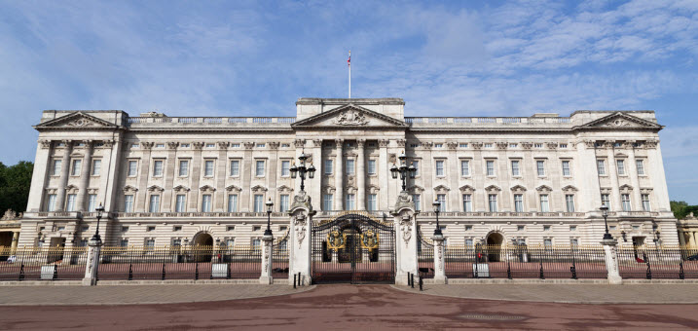
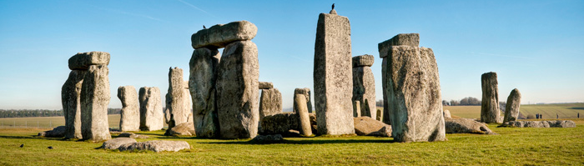
Buckingham Palace
Stonehenge

Slide 10
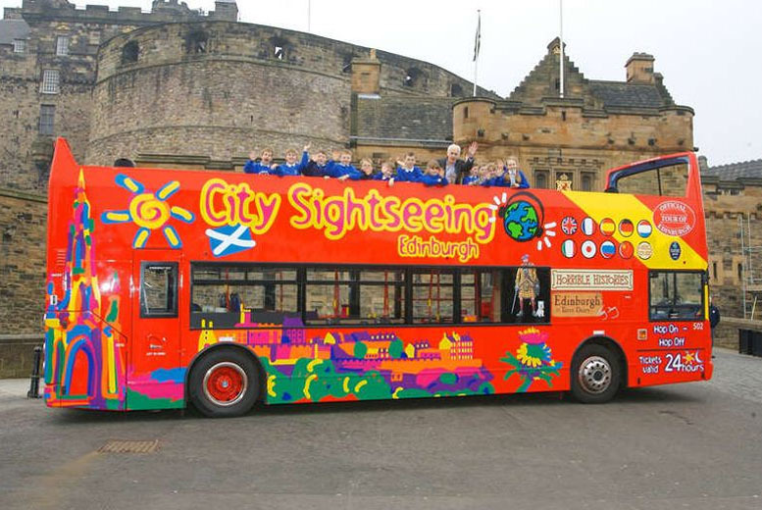
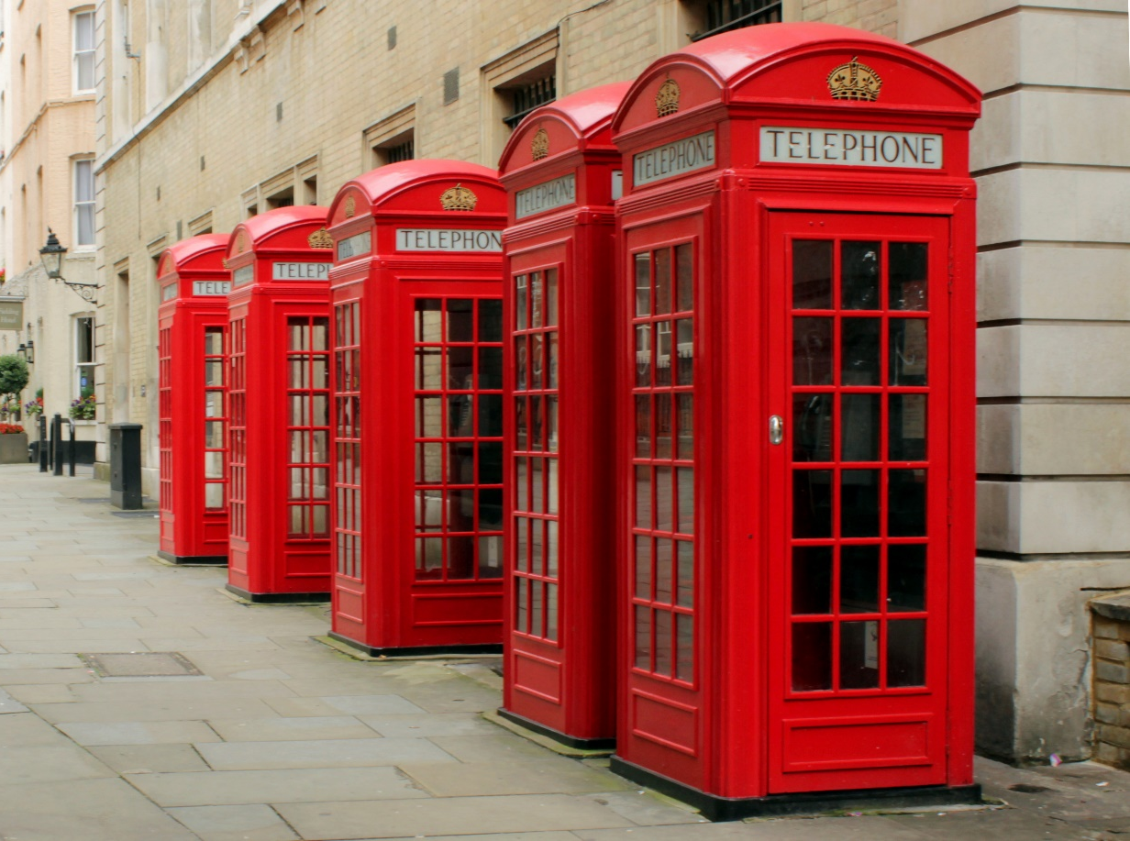
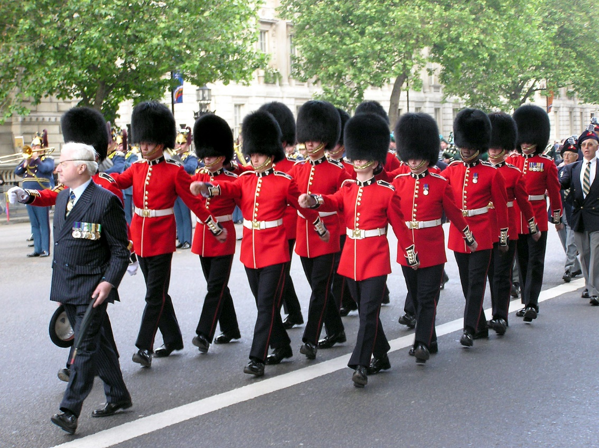
Hop on-Hop off
City Tour Bus
Red Public Phone Boxes
Marching Guards

Slide 11
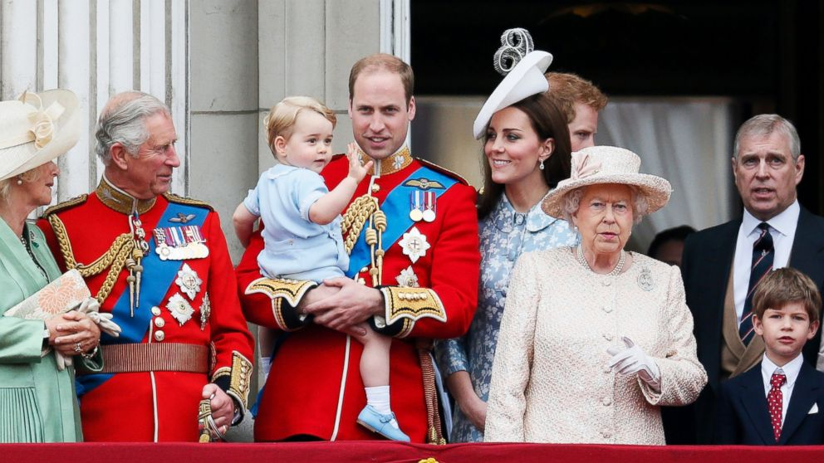
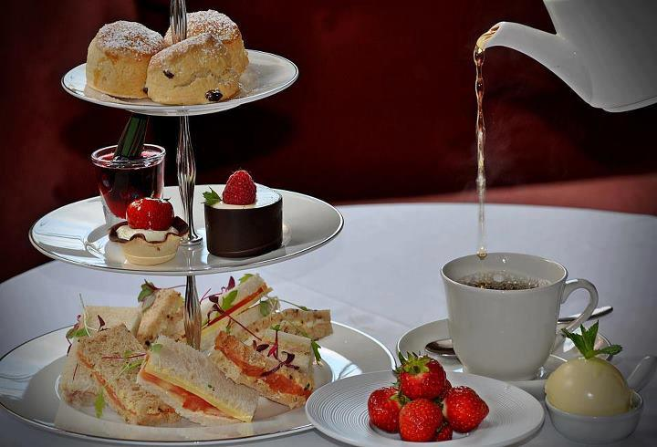
Sherlock Holmes
Royal family
Afternoon tea

Slide 12
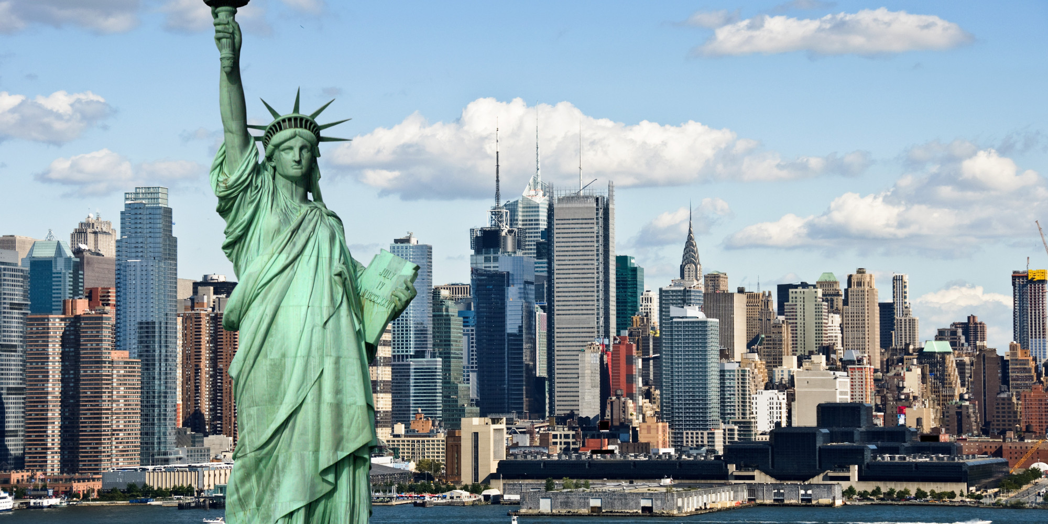
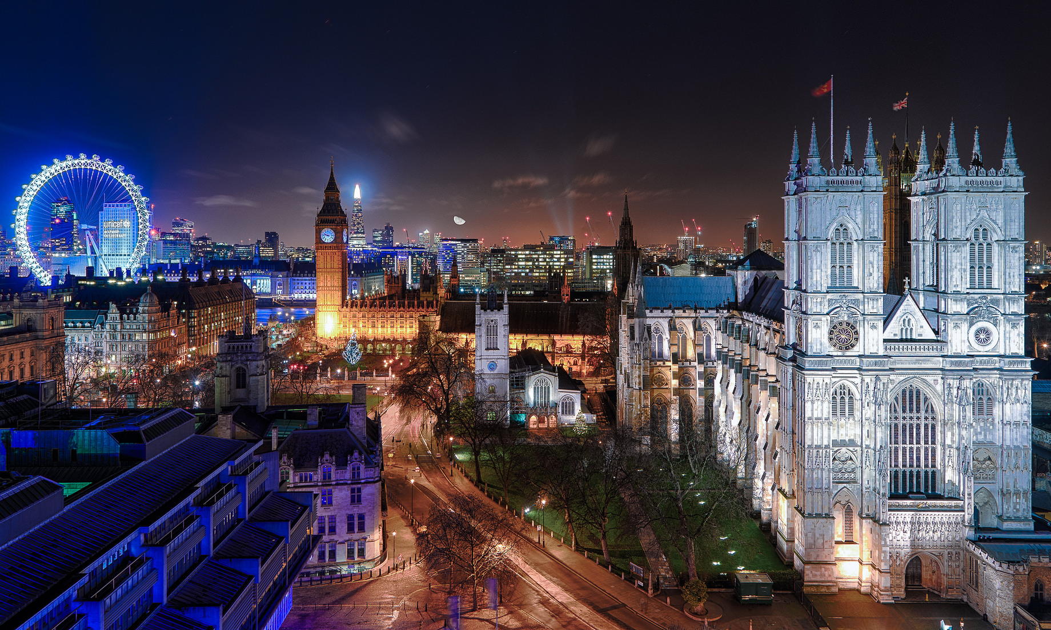
Wrong Direction V.S. One Direction
New York V.S. London

Slide 14
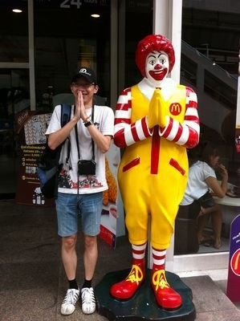
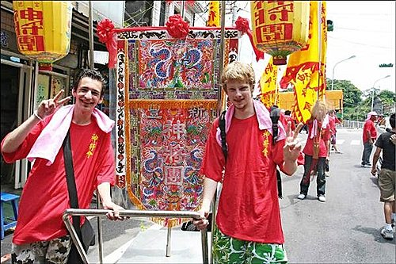
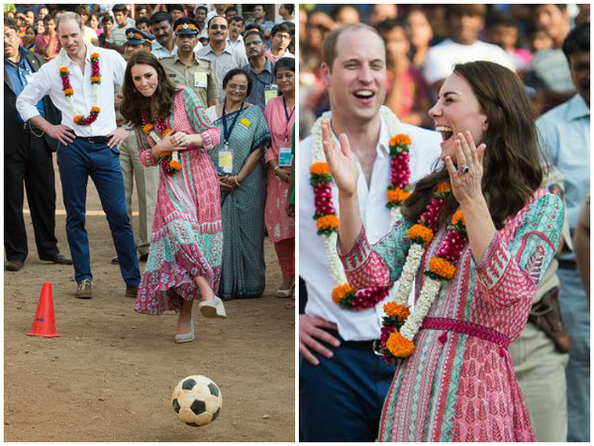
When in Rome, do as the Romans do.
入境隨俗

Slide 15
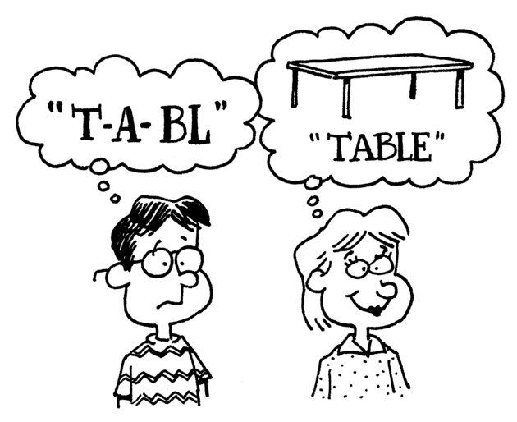
Phonics Time

Slide 16
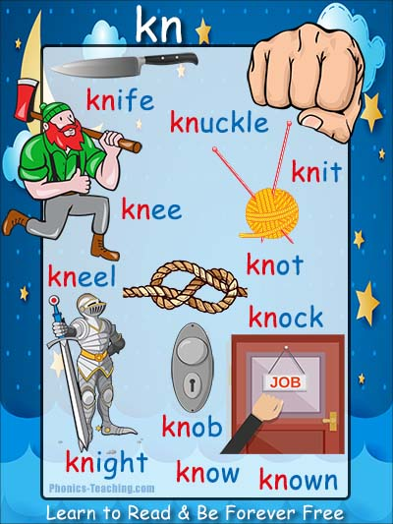

Slide 17
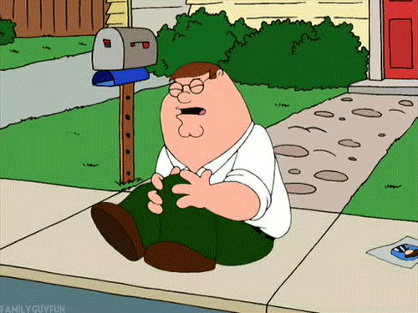
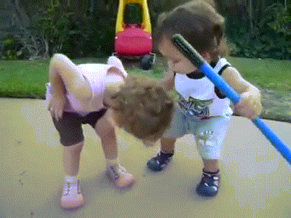
kn
ee

Slide 18
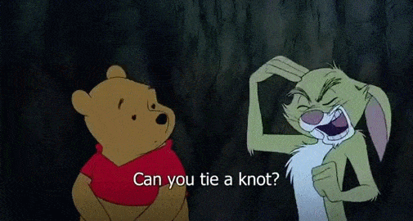
kn
ot

Slide 19
kn
ife
knife→knives

Slide 20
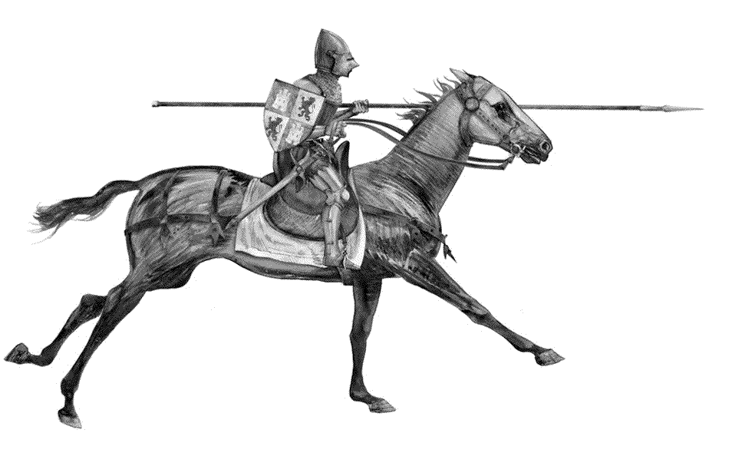
kn
ight

Slide 21
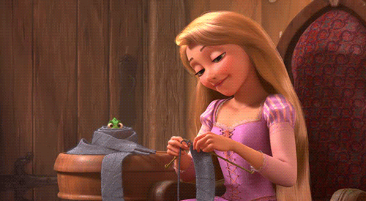
kn
it

Slide 22
kn
ock

Slide 23
Let’s twist our tongues!

Slide 24
The knight with a knife ties a knot on his knee.

Slide 26
Kevin is a cool knight. He can knit with knives.
He flies a kite at night.
Everyone knows Kevin the knight.

Slide 27
Knock, knock, knocking on Penny's door
https://www.youtube.com/watch?v=jrzUsHNGZHc

